Slide 1
EDA on Car Sales Data
BY
NIRMAL PANDA

Slide 2
Table of Contents
Introduction
Problem Statement
Description of the Dataset
Exploratory Data Analysis
Conclusion
Actionable Insights

Slide 3
Introduction
The car sales is dependent on multiple factors like brand name, model, year of purchase, body type, fuel, mileage, engine type, drive and price.
We are using EDA:
To identify key factors influencing the car sales.
To help car manufacturers understand the consumer behavior and purchase pattern.
To help the car manufacturers in devising right strategy for new product development and launches.
To help the car manufacturers to grow sales and gain market share.

Slide 4
Problem Statement
To find patterns in the new car sales data.
To determine relationship in the data.
To identify important factors that attribute to new car sales.
To identify the customer preferences and their purchase behavior over a period of time.

Slide 5
Description of the Dataset
Dataset link:https://raw.githubusercontent.com/insaid2018/Term-1/master/Data/Projects/car_sales.csv
Column Name | Description
car | Car brand name
model | Available car different Variants
year | Purchasing Year
body | Body type-Hatchback, Sedan, Crossover etc
mileage | Car Mileage
engV | Engine version
engType | Car Fuel type - Petrol, Diesel, gas etc
drive | Wheel Drive Front, back
registration | Check if the vechile is registered
price | Price of Car in $

Slide 6
Exploratory Data Analysis

Slide 7
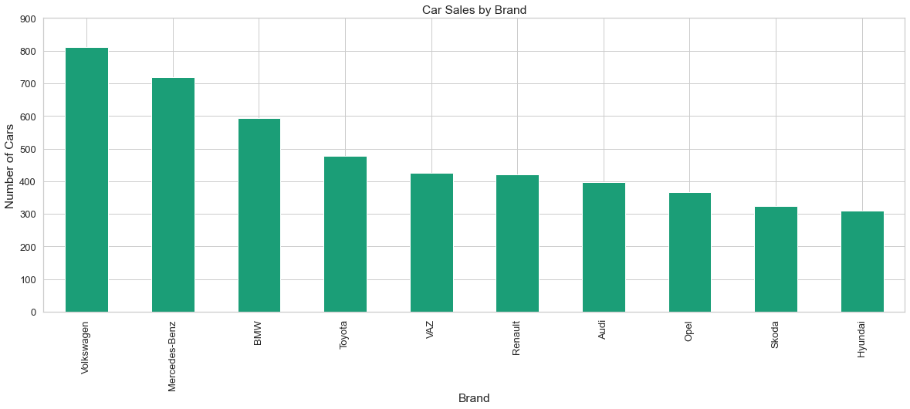
Car Sales by Brand : Top 10
Volkswagen, Mercedes-Benz and BMW are the top three brands being preferred by customers

Slide 8
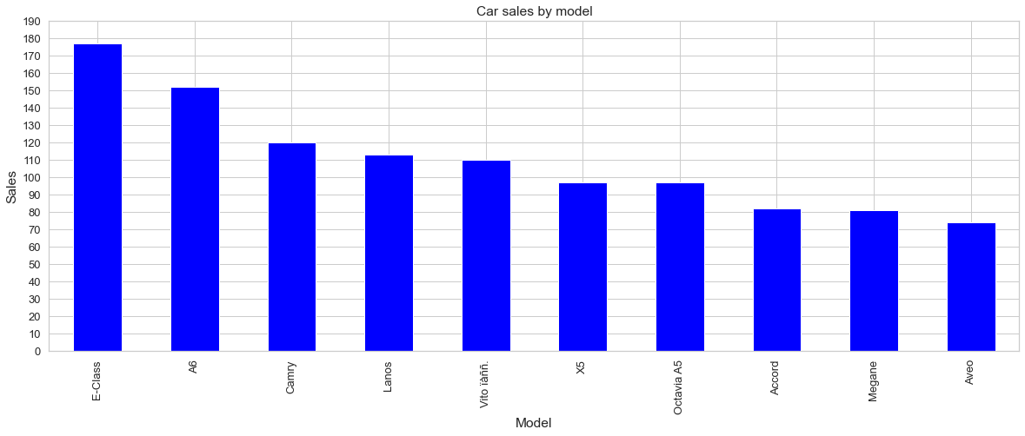
Car Sales by Model: Top 10
E-class (Merc), A6 (Audi) and Camry (Toyota) are the top three selling models (all sedan) being preferred by customers

Slide 9
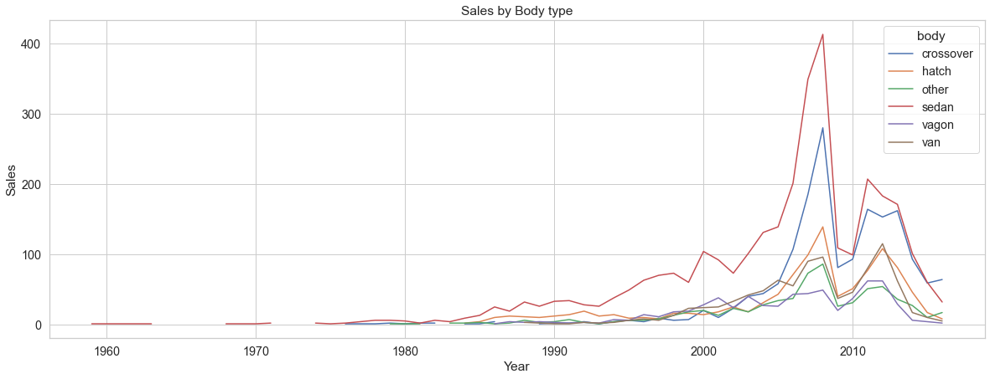
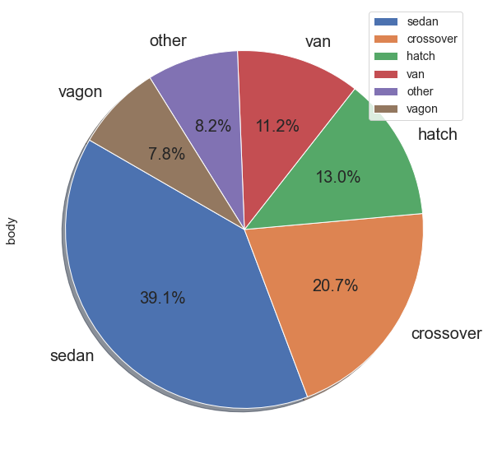
Car Sales by Body Type
Sedan has been the top choice of customers followed by crossover
In the past few years the trend of Crossover is catching up with sales more than the sedan in the recent year

Slide 10
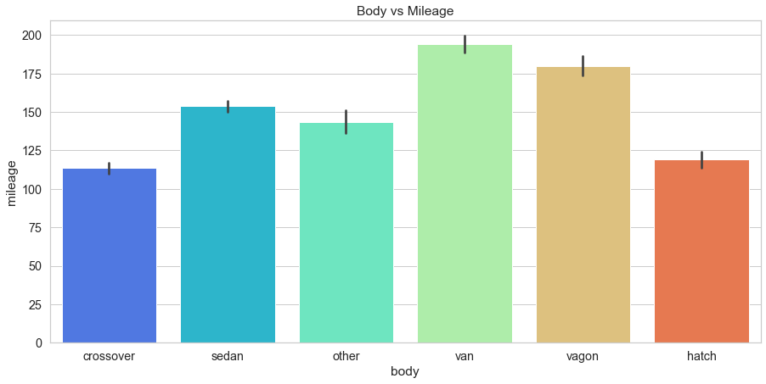
Car Body vs Mileage
Best mileage is being offered by van followed by vagon
Sedan, Crossover and Hatch has lower mileage but still are the top three choices
We can infer mileage has less impact on customer choice in buying decision

Slide 11
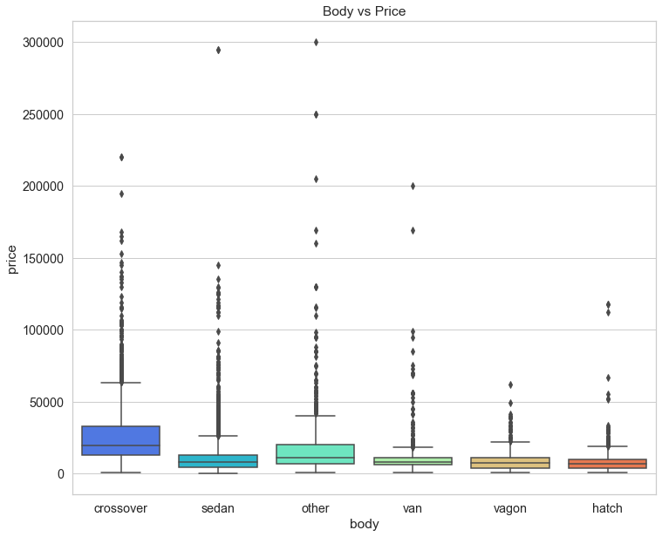
Body vs Price
Popularity of Sedan over years can be attributed to competitive pricing vis a vis other body types
Crossovers are twice expensive than Sedan on an average
Pricing plays an important role along with other attributes

Slide 12
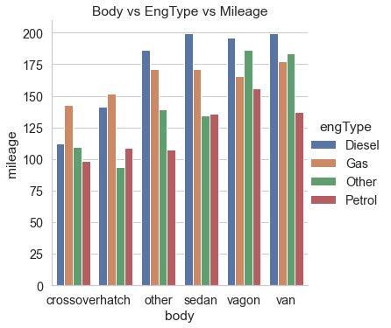
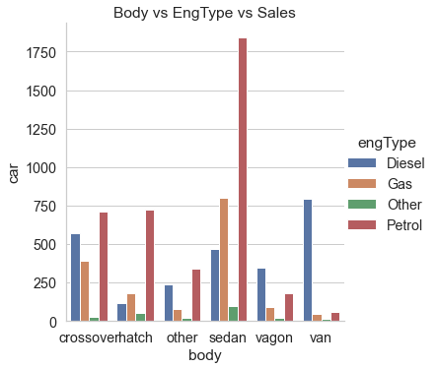
Body vs Engine Type vs Mileage vs Sales
Petrol is the preferred fuel irrespective that diesel and gas cars have more mileage
Diesel is preferred for bigger vehicles where torque requirement is more like van, vagon and even crossover

Slide 13
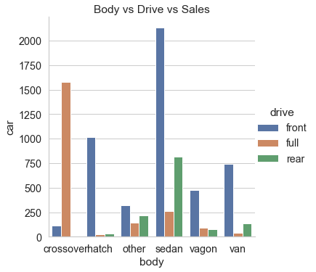
Body vs Drive vs Sales
Front wheel drive is the most preferred technology across body type except crossover.
Front wheel drive is preferred for city driving
Full Wheel Drive is preferred when it comes to crossover cars
Customers are looking for performance over driving pleasure along with off-roading capabilities when buying crossover

Slide 14
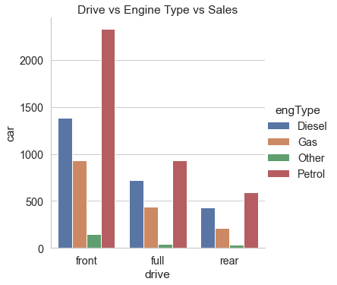
Drive vs Engine Type vs Sales
Similar trend in the choice of fuel across various drive options.
Petrol is most preferred followed Diesel and Gas across drive.

Slide 15
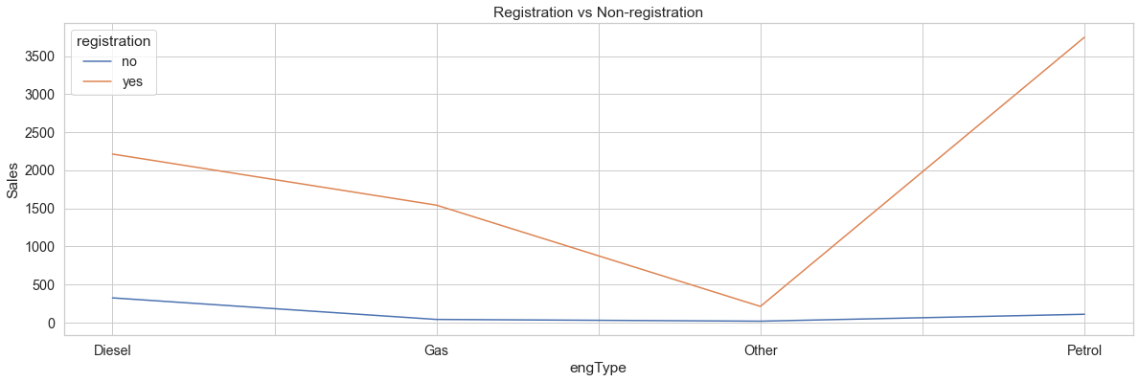
Registration of Cars by Fuel
Non-registration as a percentage of sales is mostly seen in diesel cars
Almost 14% of diesel cars purchased were not registered
High diesel car price and high registration fee, government regulations could be a reason

Slide 16
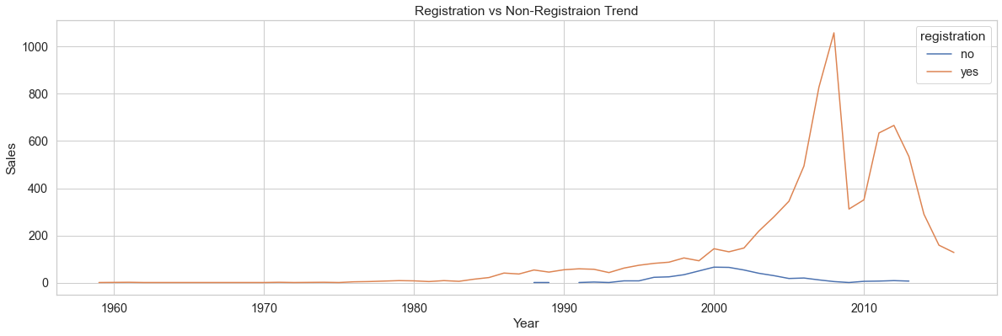
Registration of Cars by Year
1993-2002 is the period we can see steep rise in the non-registration of cars vis a vis sales
2003 onwards the trend of non-registration has declined.
In the last three years there has been no reported case of non-registration of new cars purchased.

Slide 17
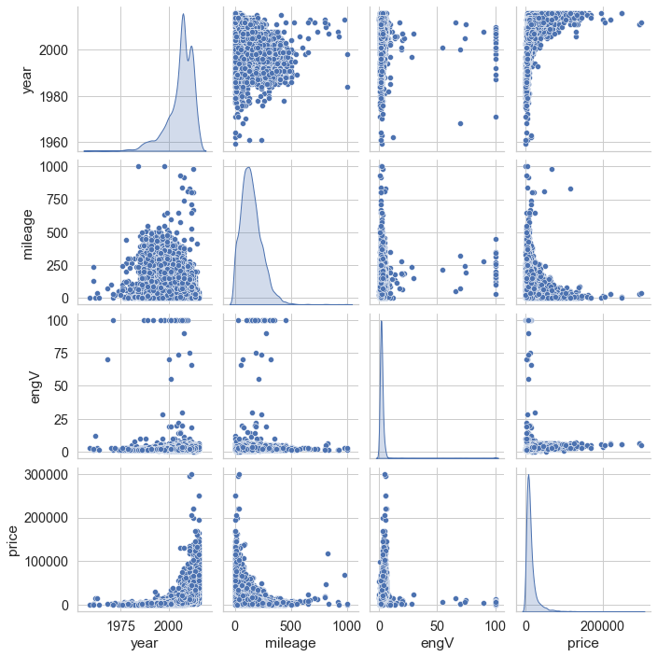
Pair Plot to find correlation
No strong positive or negative co-relation between the variables
Year and price showing some moderate positive correlation
Year and mileage showing some signs of moderate negative correlation
Price and mileage also showing some moderate negative correlation

Slide 18
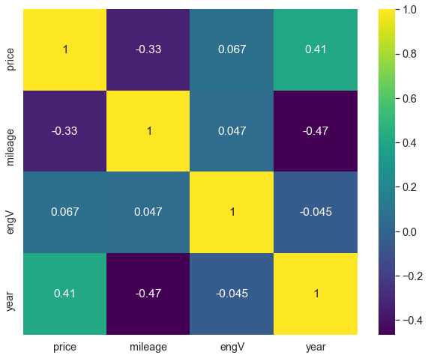
Correlation using Heat Map
Year and Price have moderate positive correlation, R = 0.41, which means with every passing year there has been an moderate increase in the car prices.
Year and mileage have moderate negative correlation, R = - 0.47, which means there has been no impact of the mileage factor on the car sales.
Price and mileage have moderate negative correlation, R = - 0.33, which means low or high mileage doesn’t impact the price of the car.
All other variables have very week correlation with each other.

Slide 19
Conclusion
Sedan is most preferred car followed by crossover and hatch.
Crossover and hatch has less mileage than other body types.
Best mileage is being offered by Van and Vagon, which sells the least.
Sedan has been popular over years due to its competitive pricing vis a vis other body types.
Crossovers are twice as expensive as Sedans, but the sales is catching up with Sedan.
Customers prefer all the fuel types across body type.
Petrol is the most preferred fuel type followed by diesel and gas.
Petrol cars are more preferred irrespective of low mileage compared to diesel and gas cars.
Front Wheel Drive is most preferred technology across body type, except crossover which is more popular with Full Wheel Drive.
Non-Registration of cars is a passe. Customers are now registering their new cars.

Slide 20
Actionable Insights
Trend of Crossover has caught up as a promising segment for manufacturers.
Car manufacturers should focus to launch more crossover models apart from Sedan line-up.
Crossovers need to be competitively priced for higher sales growth and bigger market share than Sedan.
Price sensitive Sedan customers will switch to Crossover with affordable options.
Current generation Customers are looking for performance and off-roading capabilities.
Manufacturers have to offer cars models with all the fuel options specially with petrol, diesel and gas.
Mileage is not an important criteria for customers when it comes to car buying. So manufacturers focus should be more on performance and features.
Additionally, before performing further analysis it would be prudent to collect more data on variables like customer location (rural, urban, semi-urban), usage (daily, weekends), passenger (solo, family), driven by (self, driver), age, gender, registration (private vs commercial), car specification and features, etc to have better customer insights.

Slide 21
THANK YOU

